Slide 1
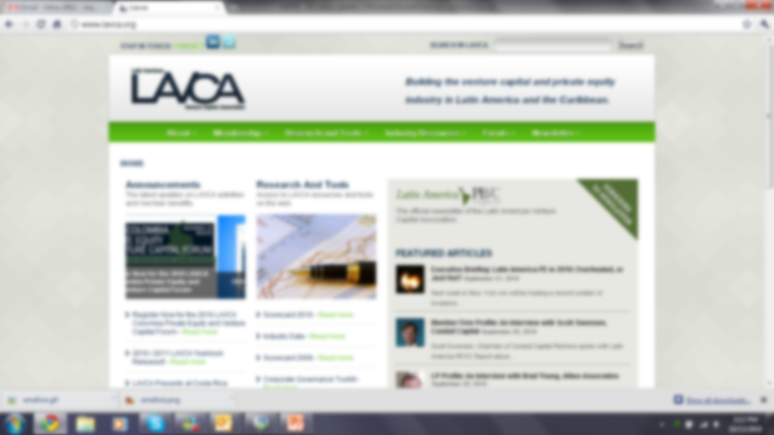

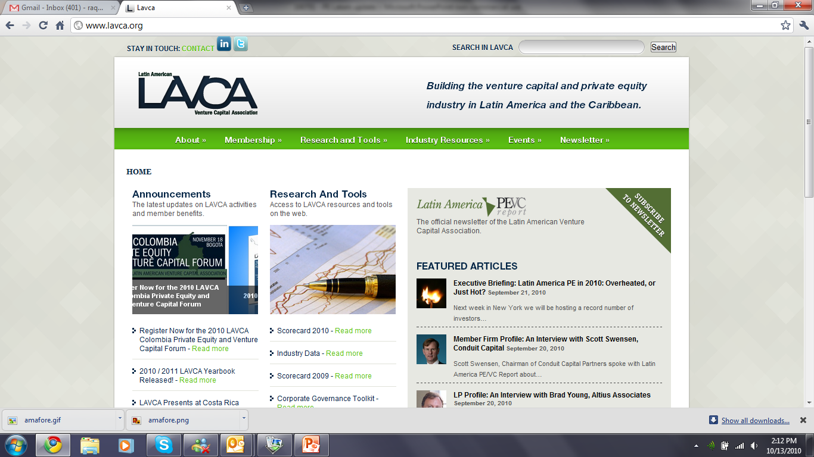
Update on Venture Capital in
Latin America
AS/COA LAVCA Miami Event
April 18th, 2013
Cate Ambrose
President & Executive Director
Latin American Private Equity & Venture Capital Association
New York
October 7, 2011

Slide 2









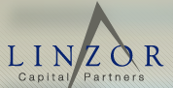



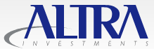
LAVCA Overview
Mission
To spur regional economic growth by advancing venture capital and private equity
investment through programs of research, networking, investor education, the promotion of best investment practices, and the advocacy of sound public policy.
Members
LAVCA’s membership is comprised over 150 firms which control assets in excess of US$50 billion, directed at capitalizing and growing Latin American businesses.
Some of the best known global and regional fund managers are members of LAVCA:
LAVCA is supported by:
Notes:
LAVCA is a not-for profit membership organization dedicated to supporting the growth of private equity and venture capital in Latin America.
LAVCA’s membership is comprised over 150 firms which control assets in excess of $50 billion, directed at capitalizing and growing Latin American businesses.

Slide 3
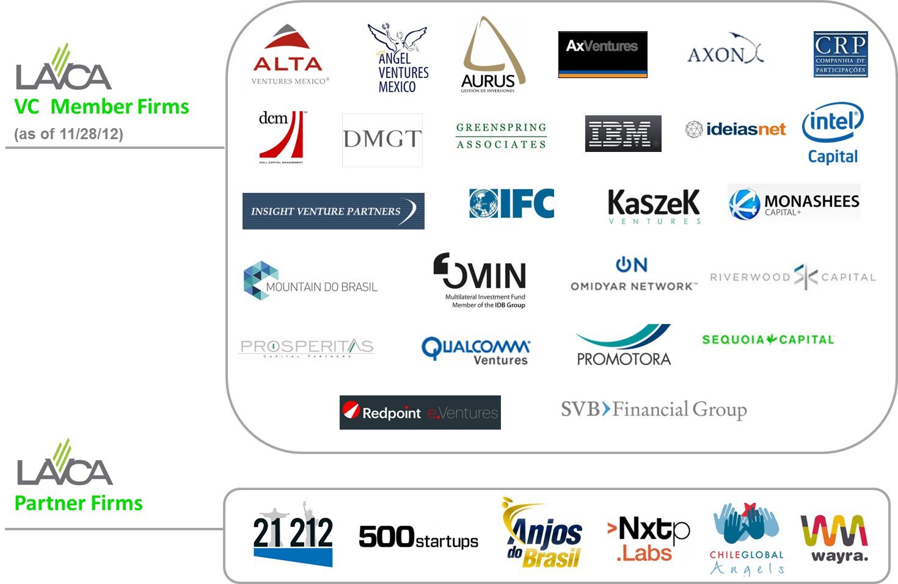
LAVCA Overview
VC Member Firms and Partners
Notes:
LAVCA is a not-for profit membership organization dedicated to supporting the growth of private equity and venture capital in Latin America.
LAVCA’s membership is comprised over 150 firms which control assets in excess of $50 billion, directed at capitalizing and growing Latin American businesses.

Slide 4
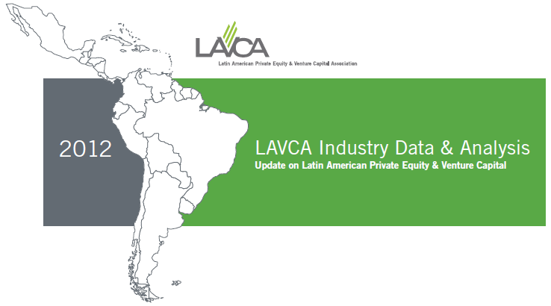




Research and Products
2012 LAVCA Industry Data and Midyear Reports
Cited in multiple publications including, WSJ.com, NYTimes.com, Bloomberg BusinessWeek, Reuters, Private Equity International, and peHUB Wire.
LAVCABase
The Latin American Investor Network, is the only comprehensive online database of Latin America private equity and venture capital fund managers.
Coller Capital / LAVCA LP Survey
The first comprehensive survey of Latin American PE of its kind, providing
a unique perspective of the issues and opportunities facing private equity
investors in the region.
The Latin America PE VC Report
The Latin America PE VC Report is the official newsletter of the Latin American Venture Capital Association.
2011 LAVCA Scorecard
Produced in collaboration with the EIU the LAVCA Scorecard ranks 12 countries based on 13 indicators.

Slide 5
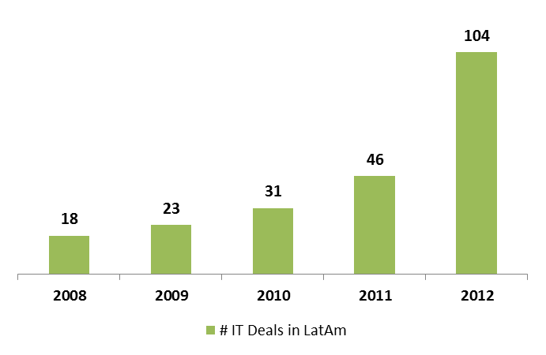
Information Technology Deals Expand
The number of IT deals in Latin America have grown faster than any other sector in the last five years, driven by early stage investments
Deals in the IT Sector in Latin America
(in # of deals, 2008-2012)
© 2013 LAVCA Industry Data

Slide 6
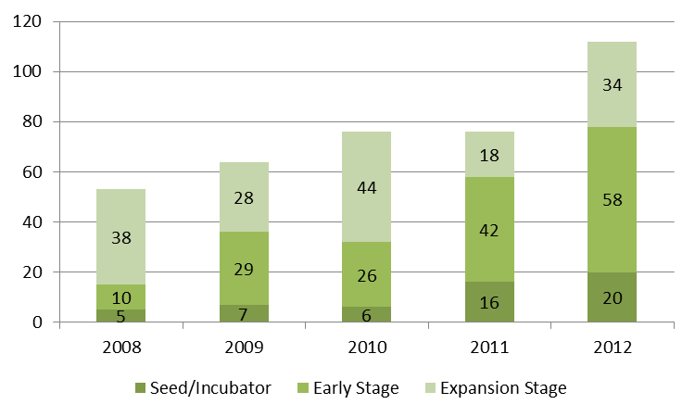
A New Era for VC Investments
Seed, Early and Expansion Stage deals grew 47% compared to 2011.
Brazil accounted for 2/3 of VC investments, followed by Chile (10%) and Argentina (6%).
Seed, Early and Expansion Stage Investments
(in # of deals, 2010-2012)
© 2013 LAVCA Industry Data

Slide 7
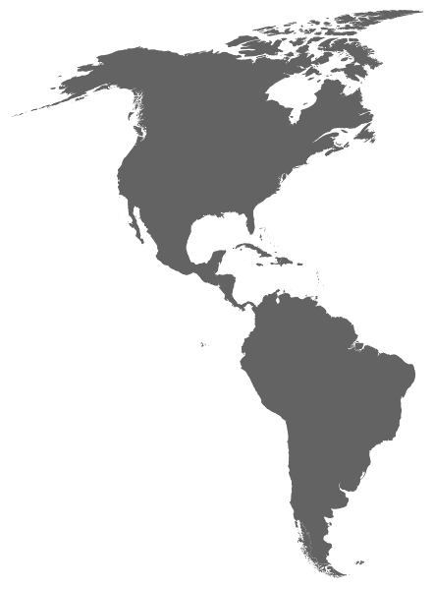








Silicon Valley heads to LatAm
With LatAm Portfolio Companies
With LatAm Portfolio Companies & Local Offices
© 2013 LAVCA Industry Data

Slide 8




















The Ecosystem explodes in LatAm
Public Support
Incubators & Business Accelerators
Angel Investor
Networks

Slide 9
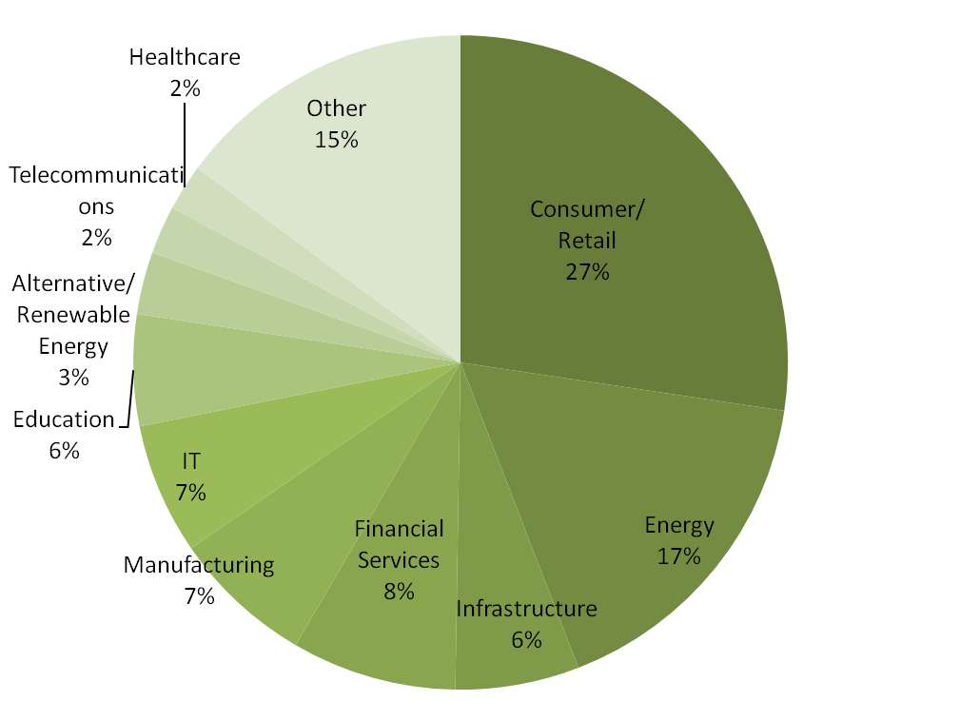
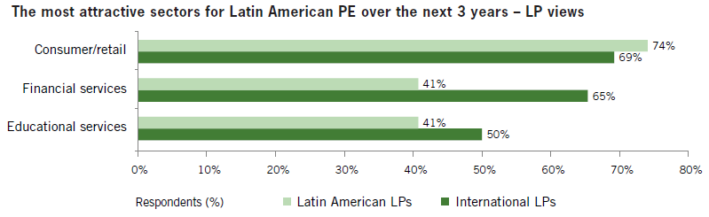
The Consumer Trend
Investments by Sector
(in % of USD, 2012)
Consumer/Retail was the most popular sector by dollars invested (27% of total).
This trend is in line with LP expectations, reflected in the CollerCapital/LAVCA LP Survey.
© 2013 LAVCA Industry Data

Slide 10















E-commerce and consumer internet deals
Highlighted VC Investments
E-commerce
Others
Education
Open Data
Mobile games
© 2013 LAVCA Industry Data

Slide 11

Case Study:
Funding a Start-up
Angel Capital
Early Stage Capital
Expansion Capital
© 2013 LAVCA Industry Data

Slide 12
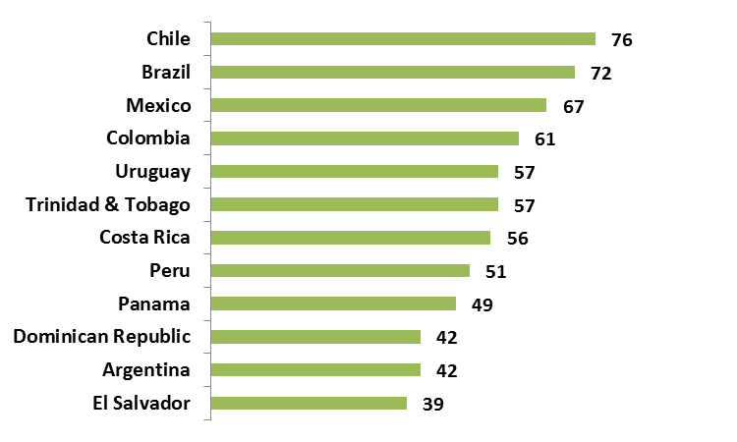
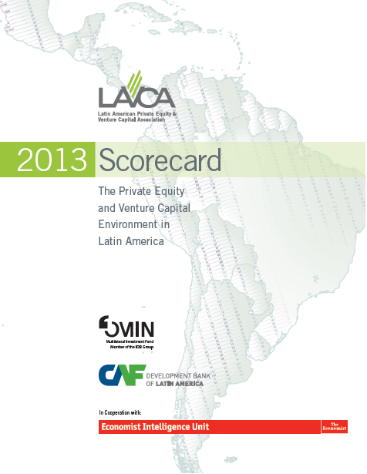
LAVCA Scorecard – 2013 Ranking
Overall score – 0-100 where 100=best environment
© 2012 LAVCA Industry Data

Slide 13

LAVCA Scorecard – 2013 Ranking
Entrepreneurship
Colombia and Mexico advance in entrepreneurship in 2013
Scored from 0-4 where 4=best
UK
Argentina
Brazil
Chile
Colombia (+1)
Mexico (+1)
Costa Rica
Dominican Republic
El Salvador
Peru
Trinidad & Tobago
Uruguay
Panama
© 2012 LAVCA Industry Data

Slide 14
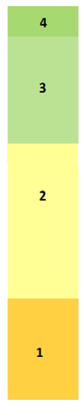
LAVCA Scorecard – 2013 Ranking
Protection of minority shareholder rights
Scored from 0-4 where 4=best
UK
Brazil
Chile
Colombia
Mexico
Argentina
Dominican Republic
Panama
Trinidad & Tobago
Uruguay
Costa Rica
El Salvador
Peru
© 2012 LAVCA Industry Data

Slide 15
LAVCA Scorecard – 2013 Ranking
Intellectual Property Rights
Scored from 0-4 where 4=best
UK
Chile
Costa Rica
Trinidad & Tobago
Argentina
Brazil
Colombia
El Salvador
Mexico
Panama
Peru
Dominican Republic
© 2012 LAVCA Industry Data

Slide 16
Thank You!
Cate Ambrose
a
President
cambrose@lavca.org
New York Headquarters
589 Eighth Avenue,
18th floor New York,
NY 10018
Tel: 1.646.315.6735
Fax: 1.646.349.1047
Regional Office
Av. Figueroa Alcorta 3351,
office 001 Buenos Aires,
Argentina, 1425
Tel: +54.11.4806.1154

