Slide 1

Argentina’s Economic Outlook
Temporary equilibria: Mild recession and high inflation ahead
Juan Luis Bour
Council of the Americas
New York City, May 9th, 2014

Slide 2
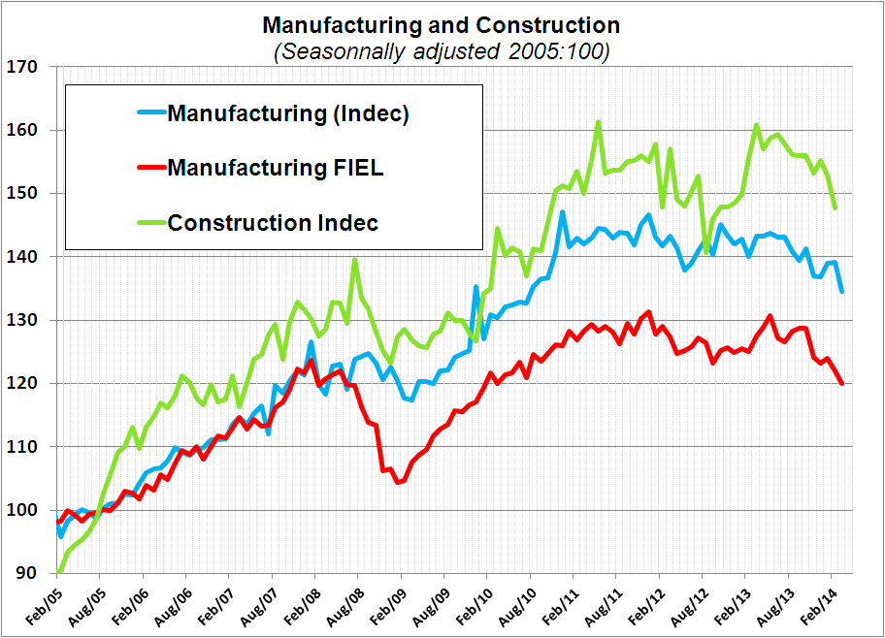
Manufacturing and Construction: 3 quarters of (sa) falls.
Quarter to quarter % change (sa)
Quarter | Manufacturing |  | Construction
 | INDEC (EMI) | FIEL (IPI) | INDEC (ISAC)
Q3 2013 | -1.6% | -0.9% | -1.1%
Q4 2013 | -2.0% | -2.0% | -1.2%
Q1 2014 | -0.6% | -2.7% | -2.6%

Slide 3
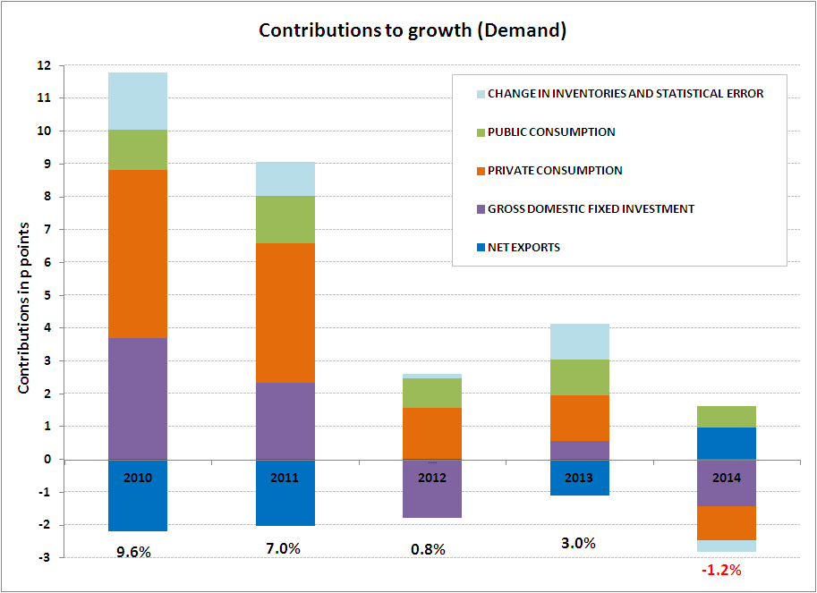
GDP: fall (sa) since Q4 2013.
(I) The demand side. Net exports (no growth contribution, except in 2014 because of major import fall)
Investment: cyclical downturns in Equipment and Construction.
Private consumption: from Consumption-led growth to adjustment.

Slide 4
(II) The supply side
CONTRIBUTIONS TO GROWTH (percentage points, GDP at factor cost)
 | Agriculture | Manufacturing | Construction | Commerce, Hotels | Financial | Other services
2010 | 1.69 | 1.31 | 0.41 | 1.87 | 0.35 | 2.95
2011 | 0.20 | 0.65 | 0.50 | 0.97 | 1.13 | 3.11
2012 | -0.73 | -0.09 | -0.18 | -0.16 | 1.03 | 1.27
2013 | 0.37 | 0.09 | 0.06 | 0.25 | 0.54 | 1.53
2014 | 0.42 | -0.83 | -0.26 | -0.53 | 0.15 | 0.36
(A) 2010-13 | 0.38 | 0.49 | 0.20 | 0.73 | 0.76 | 2.22
(B) 2014 - (A) | 0.03 | -1.32 | -0.46 | -1.26 | -0.62 | -1.85
No major contributions to growth since 2012 from Manufacturing, Construction and Commerce.
Most sectors with a lower contribution to growth than average previous 4 years, except Agriculture.
The main buffers in 2014, other than Agriculture: Transport &Communications, Financial sector.

Slide 5
The statistical nightmare
 | Before | After | Difference | Observ
TRADE (billion USD)
Exports (year) | 83.03 | 81.66 | -1.37 | Billion USD
Imports (year) | 74.00 | 73.66 | -0.34 | Billion USD
Trade Bal (year) | 9.03 | 8.00 | -1.03 | Billion USD
INFLATION (accumulated)
CPI (Jan-March) | 2.37 | 9.97 | 320.7% | % change
Supermarkets (Jan-March) | 0.83 | 11.21 | 1258.2% | % change
GDP
EMAE/GDP (year) | 4.9 | 3.0 | -1.9 | pp

Slide 6
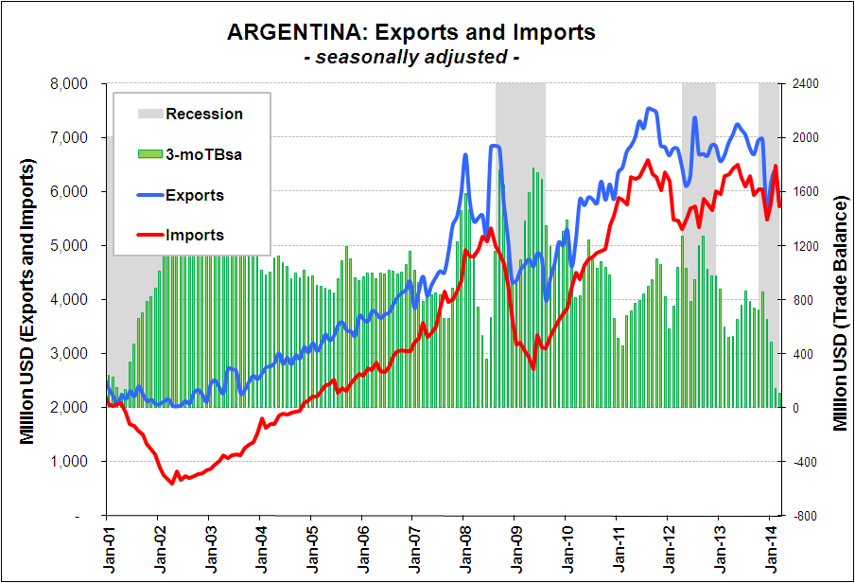
What’s behind trade figures? Exports stagnated since late 2010 – Now they fall

Slide 7
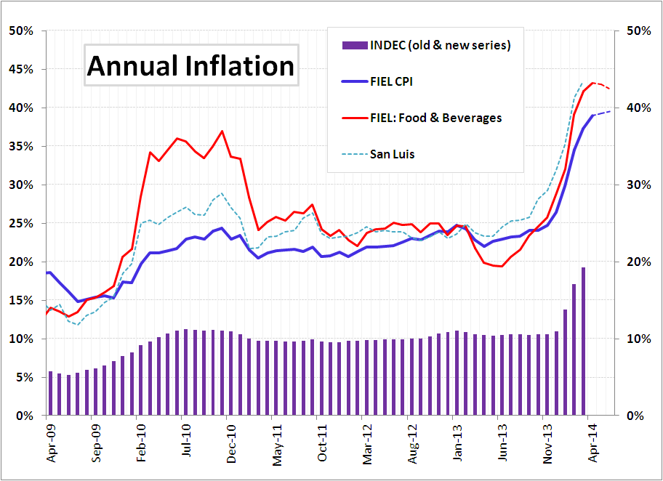
Inflation close to 40% (yoy) – Foods & Beverages >40%
Short term deceleration – Logistic curve: temporary stability around the new (higher) level

Slide 8
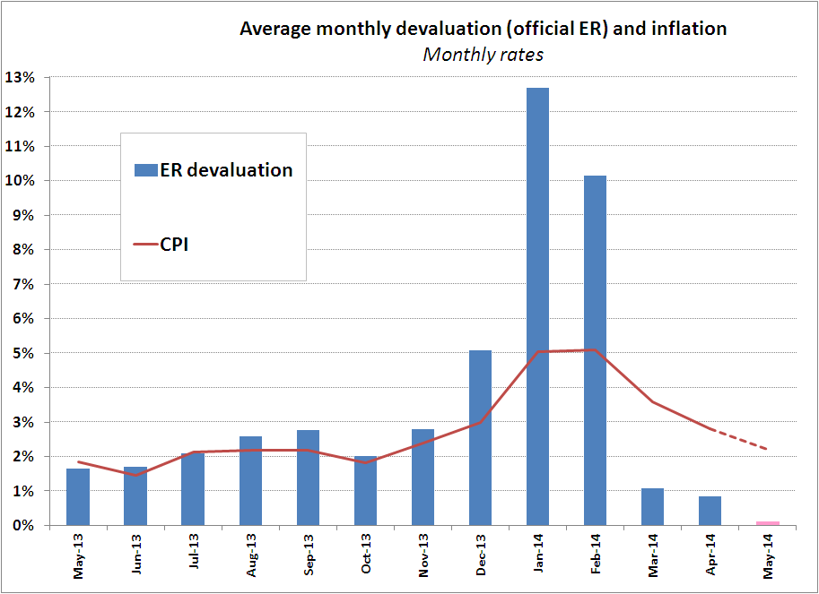
The antiinflation program: another temporary anchor (the ER)

Slide 9
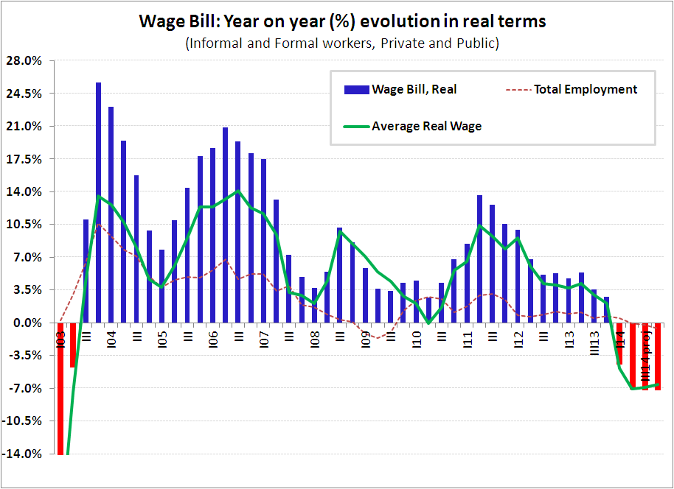
Last year we warned on wage deceleration: impact on the consumption-led growth strategy.
This year: wages as nominal anchor. The consumption boom is over.

Slide 10
Undoing subsidies without regulatory reform
Santiago Urbiztondo
Council of the Americas
New York City, May 9th, 2014

Slide 11
Public Utilities’ Context
Since 2002, regulatory paradigm increasingly diverged from any broad “best-practice” ideal:
  Confusion of public and private roles
  Direct & discriminatory price regulation in competitive segments (upstream)
  Short-run (myopic) perspective, promoting inefficient operation / investment through cost-plus tariff / subsidy adjustments, discriminating old and new investments
  Disregard to transparency, institutional credibility, consistent contracts, technical analysis, etc.

Slide 12
Public Utilities’ Context
Consequences:
  Substantial reduction of (real) tariffs, covering a fraction of total (long-run) costs
  Excessive consumption growth, but contraction of investments, exhausting existing capacity
  Complications: exploding subsidies, poorly focalized, with deteriorating coverage, quality and cost
  Perceived end of period: magnitude and composition of subsidies (energy imports) would require a major correction, reducing subsidies and increasing tariffs (and changing new paradigm)

Slide 13
Overall size & evolution of subsidies
In 2013: subsidies to public utilities added USD 22 billions, or 4.4% of GDP
  CAMMESA & ENARSA: from 55% of total in 2009 to 73% in 2013
2014: First 2 moths explosive: total subsidies increased 13% in USD, approaching 5.7% of GDP without subsidy cuts

Slide 14
Recent attempts to attack subsidies
New incentives (higher prices and promises) to YPF and other hydrocarbon producers since 2012, with no major results yet
Recovered prices of crude oil and gasoline before YPF’s expropriation
Stiff rise of new NG price since 2013 –7.5 USD/MMBTU
YPF’s public profit function post-2012 (internalizing cost of subsidized energy) → relative price recovery….
… certainly helped the “new YPF” to stop its previous production fall

Slide 15
Recent attempts to attack subsidies
New incentives (higher prices and promises) to YPF and other hydrocarbon producers since 2012, with no major results yet
Not effective to stop total market fall
Nor to induce higher investment effort (# of exploration and development wells drilled)
Vaca Muerta? Announced investments still minor vis-à-vis previous industry investment (5.2 billion USD in 2011). Substituting conventional oil and NG?

Slide 16
Recent attempts to attack subsidies
AySA’s tariff hike (nominally 170% to 405% according to location of user –high, medium and low neighborhoods) is significant, but has a small impact on total subsidies and no effect on total costs under current de facto cost-plus regime with endogenous subsidy
  With average 310% nominal tariff increase, 35% inflation and 15% real devaluation in 2014, AySA’s annual (post-august) subsidy falls 37% -USD 500 million– , or 2.3% of overall 2013 subsidies to public utilities
Total elimination of subsidy to AySA would still require 170% additional tariff increases (with 2014 assumed USD costs)

Slide 17
Recent attempts to attack subsidies
3) Natural gas
  2013 subsidies through ENARSA of 5.7 billion US$, 50% directed to residential (R) and commercial (C) users
  April 2014: partial withdrawal of subsidies to R and C, through higher wellhead prices, from +400% (<800 m3/year) to +900% (>1,800 m3/year), averaging 730% nominal AR$ increase (or 400% increase of cost of NG as large R users pay charge for imported gas), to be completed in August
  Price hikes avoided if consumption falls 20% vis-à-vis previous year (hikes halved if consumption falls 5% - 20%)
  Effect on ENARSA’s deficit unknown, but 25% is maximum reduction (as explicit subsidies informed to R users -1.0 billion USD- remain), i.e., 1.5 billion USD (or 6.9 % of total 2013 subsidies)
  Also, increases of T&D tariffs to same users (130% average, nominal ARG$, same distribution, avoiding mechanism and timing)
  60% of NG exempted (industrial users, generators, Patagonia’s R&C)

Slide 18
Recent attempts to attack subsidies
3) NG: distortive upstream NG prices for residential users
  Upstream NG prices (w/o Decree 2067) increased much more for large R users, but % changes become more homogenous –+/- 380%– considering final cost of NG (including estimated payments under Decree 2067/08)

Slide 19
Recent attempts to attack subsidies
3) NG: full-year effect of various changes on Discos’ R&C users
  In USD, direct payment by NG users post-august 2014 would be 3% higher than in 2001, and total cost of NG service provided by Discos 25% higher
  Subsidy falling from 52% to 19% of total cost of R&C NG service
  Still, USD T&D margins are 50% lower than in 2001, and upstream cost of NG is 70% lower than imports from Bolivia (10 USD/MMBTU)…

Slide 20
Conclusions
In 2014 the government finally recognized the inconsistency of its regulatory paradigm: fiscal needs call for tariff hikes
Yet, overall fiscal impact is estimated low (total subsidies fall 9%)
Also, tariff hikes are ill-designed:
  High impact on R&C, but many high-consumption users exempted
  Highly distortive, increasing discrimination across users through price signals (instead of fixed ARG$ breaks for a social tariff focus group)
  Unknown follow up: R’s USD T&D tariffs still 50% below 2001; cost of wellhead NG at 3.1 USD/MMBTU for R still 70% below imported NG…
  Does not include overall restatement of incentives, contracts, institutions, etc., to approach some form of “best practice”
Beyond 2015, moving to cost-reflective prices and a more efficient new regulatory paradigm will still be politically difficult (less than in march), but it promises great efficiency (cost-reducing) rewards

Slide 21
Fixing the Fiscal Deficit
Daniel Artana
Council of the Americas
New York City, May 9th, 2014

Slide 22
The problems at the end of 2013
High Fiscal Deficit financed with money emission and the use of Central Bank reserves
  High Inflation
Appreciated Peso in real terms
Pervasive distortions of relative prices
Controls “fatigue”

Slide 23
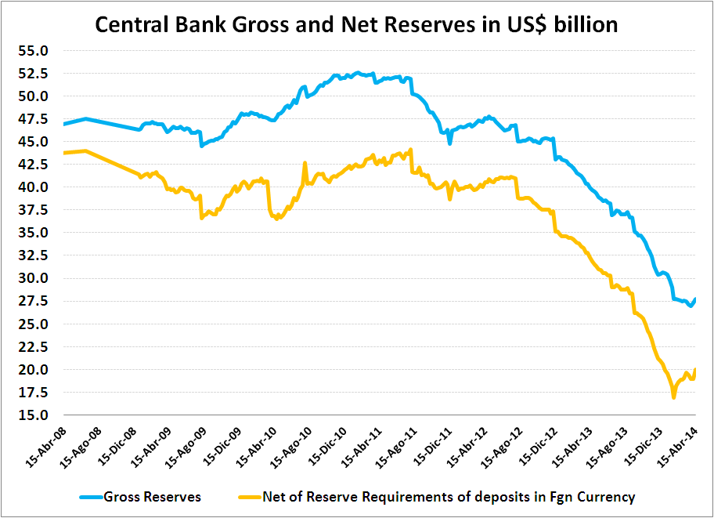

Slide 24
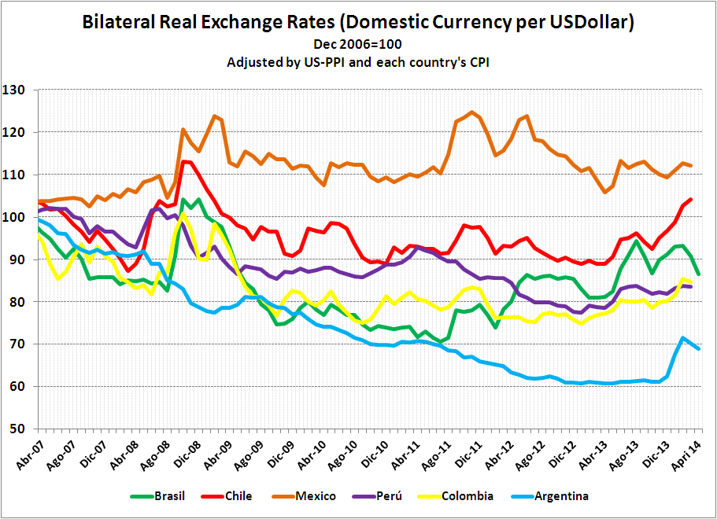

Slide 25
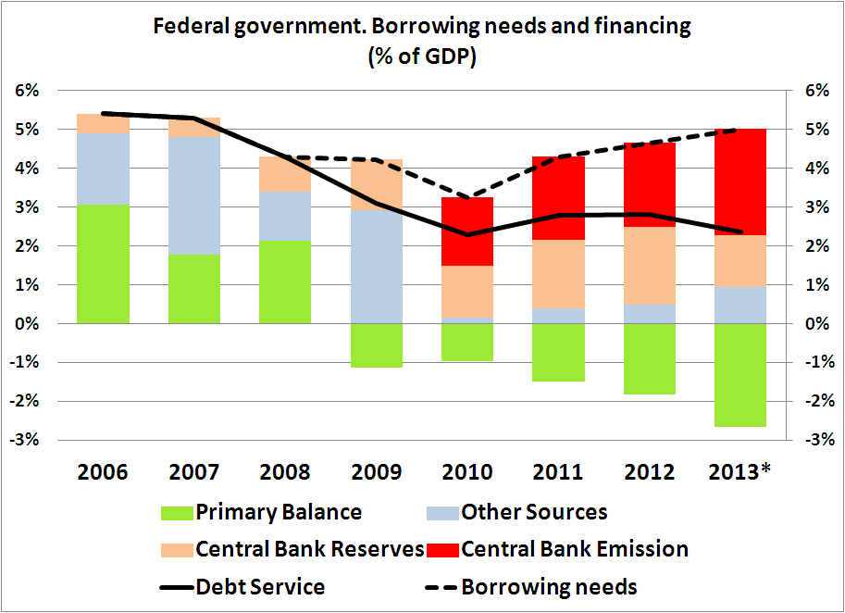

Slide 26
The government “strategy” to fix the fisc
Reduction in subsidies to energy: low fiscal impact
Reduction of transfers to provinces: Limited by wage hikes for provincial employees
Reduction of pensions and wages in real terms: seems to be the source to compensate the impact of the recession on tax collections

Slide 28
Lower than Brazil’s
Gross
Net Debt

Slide 29
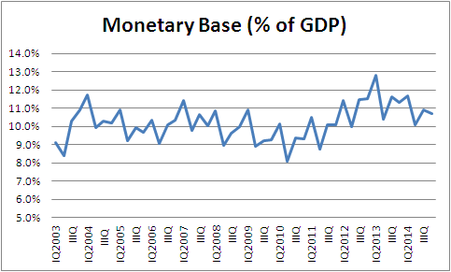
Projection with 30% increase in 2014 (Arg $ 100 billion).
Purchases of foreign exchange +20, Public Sector + 135 Lebacs/Nobacs -55

Slide 30
What would provide relief to the economy
  An agreement with the Paris Club
  Investments to develop non-conventional natural gas and oil
  New foreign loans (Federal or Provincial governments or Private Sector)
What would create additional problems
  More controls and more mistakes on policy options instead of measures to correct economic imbalances
  A sizeable decline in reserves that frightens depositors
  A US Supreme Court decision that rejects Argentina’s appeals on the hold outs case

Slide 31
The opportunities ahead
Large non-conventional gas and oil resources
  With adequate contractual regime sizeable investments are likely
Getting back to “normal”

Slide 32
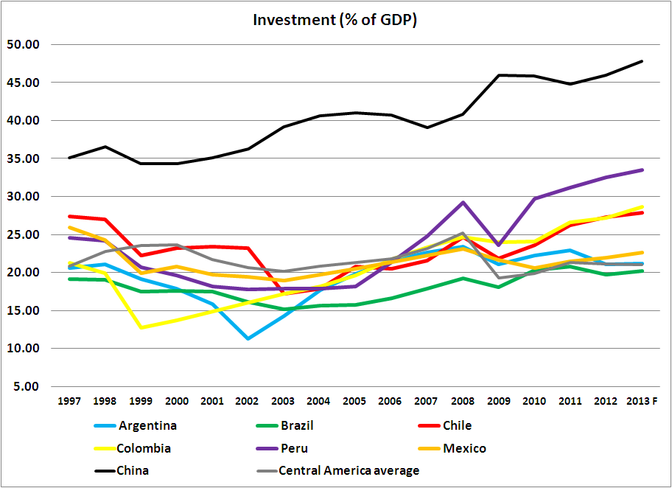
Argentina belongs to the “low-investment” group in the region

Slide 33
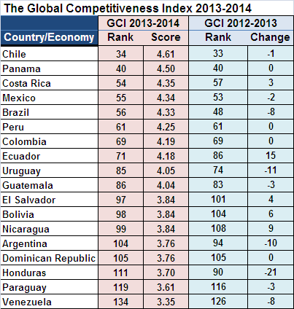
Ranking out of 148 countries.
Looks at 12 indicators of competitiviness
Average of Brazil, Chile, Colombia, Mexico, Peru & Uruguay is 60

Slide 34
Thank you!

